Slide 1
Edge Security Bootcamp
OAuth - Resource Owner Password

Slide 2
OAuth grants
An OAuth Grant is a credential representing the resource owner’s authorization. More often than not, we tend to think of grants in terms of the process used to obtain an access token.
Grant Type | Typical Use Case | Complex?
No specific resource owner is involved
Client Credentials | Business system interactions, where resources being operated on are owned by the partner, not a particular user | No
A specific resource owner is involved
Resource Owner Password Credentials | Resources are owned by a particular user and the requesting application is trusted | A bit
Authorization Code | Resources are owned by a particular user and the requesting application is untrusted | Very
Implicit | Resources are owned by a particular user, and the requesting application is an untrusted browser-based app written in a scripting language such as JavaScript | Very, and potentially insecure as well

Slide 3
Resource owner password grant type
Resources participating in password Grant Type
End User
Mobile Application
Apigee Generating and Validating Token
Authentication Server To Validate the Credentials
Backend API Resource
Resource Owner is involved, Typically owned by User and Requesting Application is Trusted
Slightly More Complex to Implement Than Client Credentials Grant Type
More Secure Than Client Credentials Grant Type
Refresh Token Generated Along with Bearer Token

Slide 4
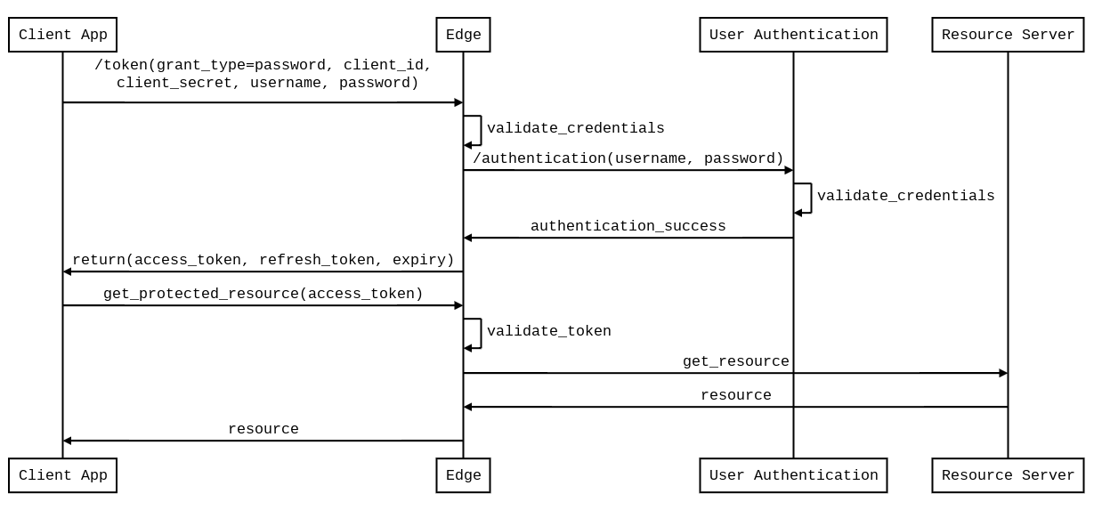
Resource owner password - Sequence diagram

Slide 5
Generate access token policy
The resource owner password grant is similar to the client credentials grant type, but with an extra step to validate the user credentials.
Edge does not validate user credentials, so an authentication service should be used.
Create this endpoint and use the OAuthV2 policy to generate an access token.
<?xml version="1.0" encoding="UTF-8" standalone="yes"?>
<OAuthV2 async="false" continueOnError="false" enabled="true" name="oauth-generate-token">
<DisplayName>OAuth Generate Token</DisplayName>
<Operation>GenerateAccessToken</Operation>
<ExpiresIn>86400000</ExpiresIn>
<SupportedGrantTypes>
<GrantType>password</GrantType>
</SupportedGrantTypes>
<GrantType>request.queryparam.grant_type</GrantType>
<UserName>request.formparam.username</UserName>
<PassWord>request.formparam.password</PassWord>
<GenerateResponse/>
</OAuthV2>

Slide 6
Responses: Client credentials vs. Password grant types
Response:
{
"issued_at" : "1407513671919",
"application_name" : "26c855a9-c485-4318-accc-7e3f533a154c",
"scope" : "",
"status" : "approved",
"api_product_list" : "[Certification_OAuthClientCredentialsWeather]",
"expires_in" : "3599",
"developer.email" : "certifieddev@apigee.com",
"organization_id" : "0",
"token_type" : "BearerToken",
"client_id" : "vn0zG4cnSWaWIzdwBZgnREI1NGORDXXz",
"access_token" : "2CsgxkPqfNtCSAZ5qGEI9x5dGdvV",
"organization_name" : "chrisv-cs",
"refresh_token_expires_in" : "0",
"refresh_count" : "0"
}
Response:
{
"issued_at" : "1407513709051",
"scope" : "",
"application_name" : "26c855a9-c485-4318-accc-7e3f533a154c",
"refresh_token_issued_at" : "1407513709051",
"status" : "approved",
"refresh_token_status" : "approved",
"api_product_list" : "[Certification_OAuthClientCredentialsWeather]",
"expires_in" : "3599",
"developer.email" : "certifieddev@apigee.com",
"organization_id" : "0",
"token_type" : "BearerToken",
"refresh_token" : "HsnXmyIQqmJJQrFVdevmVztGGASUfBfz",
"client_id" : "vn0zG4cnSWaWIzdwBZgnREI1NGORDXXz",
"access_token" : "GRQAJcgSFZcklbIUxfoUaYFW2ROd",
"organization_name" : "chrisv-cs"
}

Slide 7
Verify OAuth token policy
The OAuthV2 policy’s “VerifyAccessToken” operation will validate the access token for subsequent requests for all grant types.
Set the access token as the Bearer token in the Authorization header of the http request.
<?xml version="1.0" encoding="UTF-8" standalone="yes"?>
<OAuthV2 async="false" continueOnError="false" enabled="true" name="VerifyOAuthToken">
<DisplayName>OAuth Verify Token</DisplayName>
<Operation>VerifyAccessToken</Operation>
</OAuthV2>
curl -H "Authorization: Bearer {access_token}" http://myorg-test.apigee.net/v1/cc/oauth_cc_weather/forecastrss?w=12797282

Slide 8
THANK YOU

